Slide 1
3d-Printed Granular Jamming Hand
Melissa Indoe
Chris Kang
Sean Phelan
Maggie Serra
Chris Wallace

Slide 2
Problem Statement
PROBLEM STATEMENT FOR THE SEMESTER GOES HERE
I.e. prosthetics are a big deal and hard for some people to get access to

Slide 3
Project Objective
GOALS/OBJECTIVES GO HERE

Slide 4
Deliverables
DELIVERABLES GO HERE

Slide 5
Project Review
BRIEF SUMMARY OF WHAT WE COMPLETED UP TO PHASE 3
(THIS IS BASICALLY THE JOB OF WHOEVER IS DOING OVERALL DESIGN/ENGINEERING ANALYSIS)
(ALSO THIS SHOULD BE ABOUT 3 SLIDES)

Slide 6
Next Phase Deliverables
UPCOMING DELIVERABLES GO HERE

Slide 7
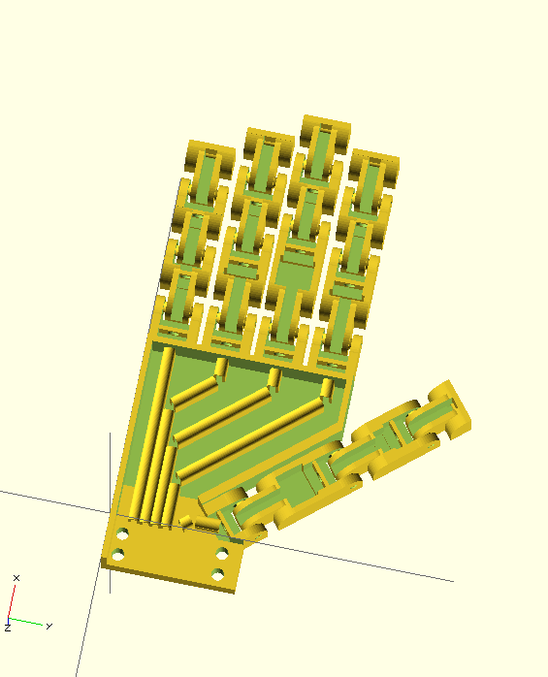
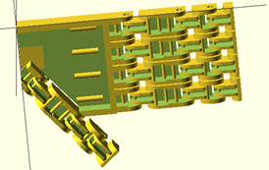
Design Modifications
There were a large number of design modifications made between phases 3 and 4
Modifications were as follows:
Updates to the base finger model
Updates to the palm model
Generation of unique finger models
Unique models were created for the
ring/index fingers, the thumb, and the
pinky
Previous (left) and current (right) hand iterations. Current hand iteration includes updated palm, updated base finger design, and realistic finger lengths.

Slide 8
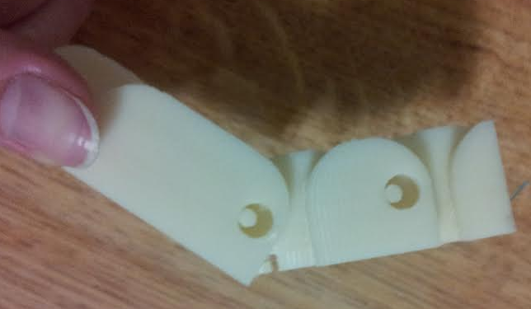
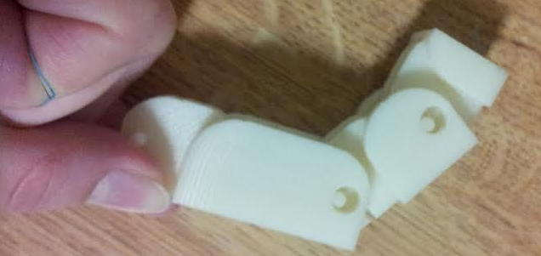
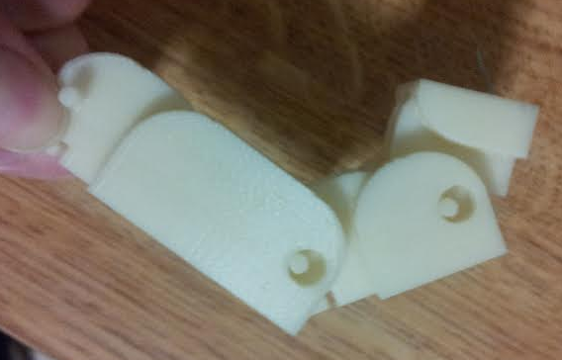
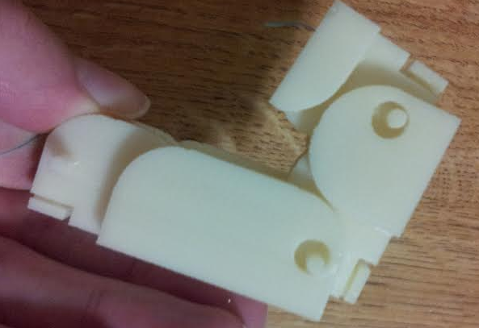
Base Finger Updates
The finger design created at the end of phase 3 was fully functional
However it was still possible to increase its ease of manufacture and its range and quality of motion
Previous finger iteration. Note the looseness of joint pins in their housings and the fact that the finger is bent to not quite 90 degrees at each joint. This is due to internal friction with the cable guides.

Slide 9
Base Finger Updates: Solution
Tapered joint pins
These improve ease of manufacture by greatly reducing the degree of overhangs
They also eliminate the need for bearings
Redesigned and repositioned cable guides
The new cable guides are flat faces with a hole for wire
This eliminates overhangs, a huge improvement over rod-shaped guides
The change in position also prevents friction when the finger is bent
Smaller tolerances
Changed to a commonly accepted value suggested by a TA
Meant to reduce the amount that joints rattle
Reduced height
This makes the fingers slightly less blocky and more realistic

Slide 10
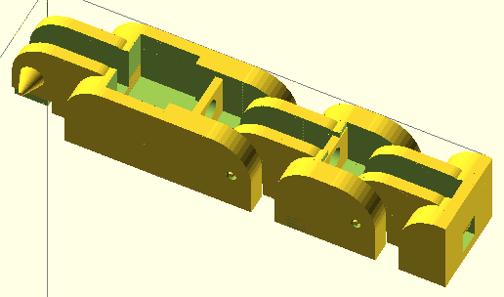
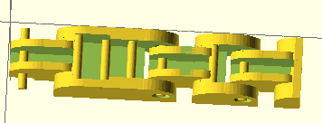
Base Finger Updates: Comparison
Previous finger iteration (left) with pin-shaped cable guides, round joint pins, and large tolerances, and new finger iteration (right) with redesigned cable guides, conical pins, and lower tolerance.

Slide 11
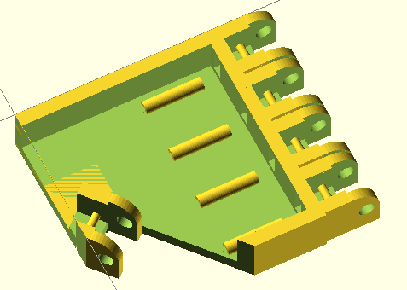
Palm Updates
The palm design was roughed out at the end of phase 3
However there was an understanding that it was not ready for manufacture
Problems with Phase 3 Palm Model:
Low-level cable guides
Forcing the cables down decreases leverage on the fingers
No guard between granular jamming pad and thumb
This could create friction with the thumb and prematurely wear out the granular jamming pad
No mounting point for the forearm
Sidewalls were very thick
This simply wastes plastic and adds extra weight
Palm design at the conclusion of phase 3.

Slide 12
Palm Updates: Solution
Taller and more complete cable guides
Guides now run through the entire palm
Therefore the wire cannot generate friction with the granular jamming pad
Height is increased
This prevents the wire from getting forced downward, impeding finger motion
Mounting point for forearm added
The forearm mounting plate includes four holes for plastic screws
Holes are slightly larger than screw diameter
This makes it possible to thread them into the forearm, ensuring a tight fit
Guard for thumb added
Prevents the granular jamming pad from creating friction with the thumb
Ensures good range of motion for the thumb and prevents wear on the pad
Thinner sides
Decreases weight and plastic usage
Larger finger spacing
Prevents bridging between fingers, ensures correct finger motion

Slide 13
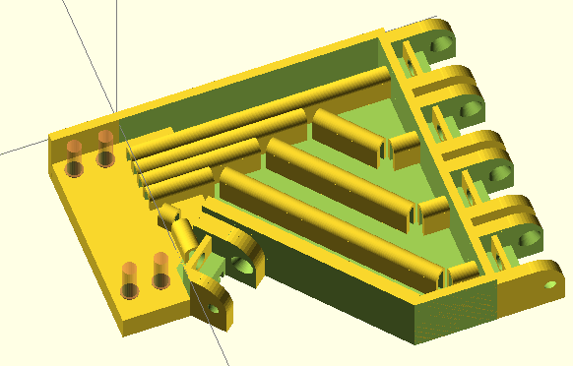
Palm Updates: Comparison
Previous palm iteration (left) with low level cable guides, no forearm mount, and no thumb guard. Current palm iteration (right) with and more complete cable guides, a forearm mount, and a thumb guard.

Slide 14
Overall Hand Updates
At the end of Phase 3 a hand design had been completed with all equally sized fingers
The hand was updated with finger lengths adjusted to exactly the length of average real, human fingers
All fingers (except the pinky) are exactly the length of the average human equivalent
The pinky is 10mm longer due to hinge constraints
Side by side comparison of old and new hand models.

Slide 15
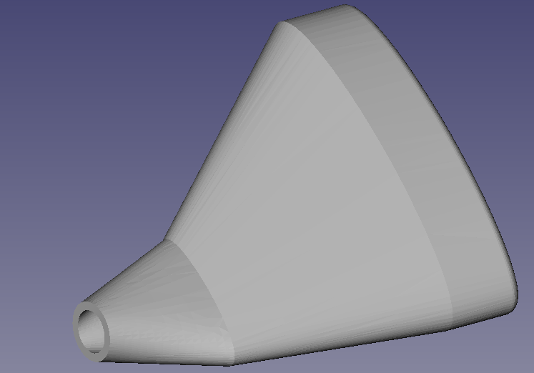
Granular Jamming Pad
The granular jamming pad has been designed
A production plan for the granular jamming pad has also been developed
3D pad model will be used to create two halves of a mold model
Mold will be 3D printed out of ABS plastic
This mold will then be used to slip cast silicone for the pad
Granular jamming pad design.

Slide 16
Prototype Fabrication and Cost
First complete hand prototype was printed February 6th
All 3D printed parts will be produced through Carnegie lab
Majority of non-printable 3D parts (motors, pump, etc) have been ordered
Cost so far: $138
$131 has been spent on non-3D printable materials
$7.05 has been spent in materials cost for the hand
Future plans for fabrication:
Hand design will be finalized within the next 1-2 weeks
Granular jamming pad design will be finalized and produced within the next 1-2 weeks
Forearm design will be finalized within the next 1-2 months

Slide 17
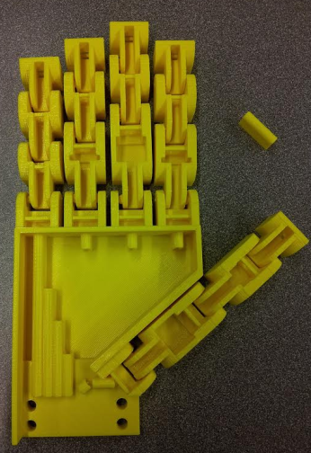
Performance Testing
The first iteration of the complete hand was a moderate success
Certain elements behaved as expected
Some elements need further improvement
The thumb especially needs improvement
Modeled (top) and printed (bottom) hand.

Slide 18
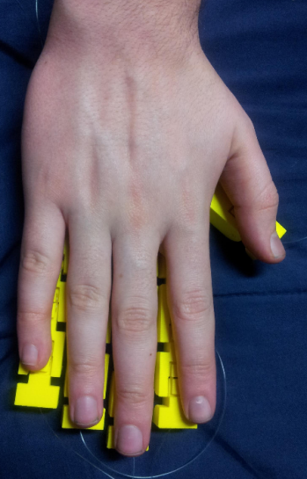
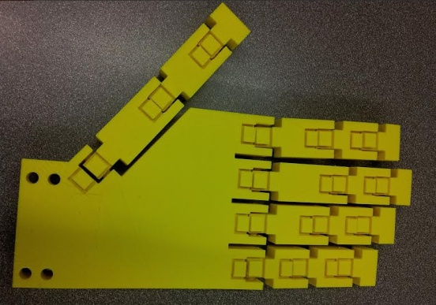
Performance Testing— Good Points
Redesigned fingers were all successful
New cable guides increased range of motion and printed successfully
Base knuckle (never previously tested) acted as expected
Fingers all worked at respective lengths
Revolute portions of the joints worked as expected
Proportions are correct
Palm design spaced fingers a reasonable distance apart
No bridging occurred between fingers
Thumb did not bridge to side of hand and could bend freely
Hand model compared to a human hand.

Slide 19
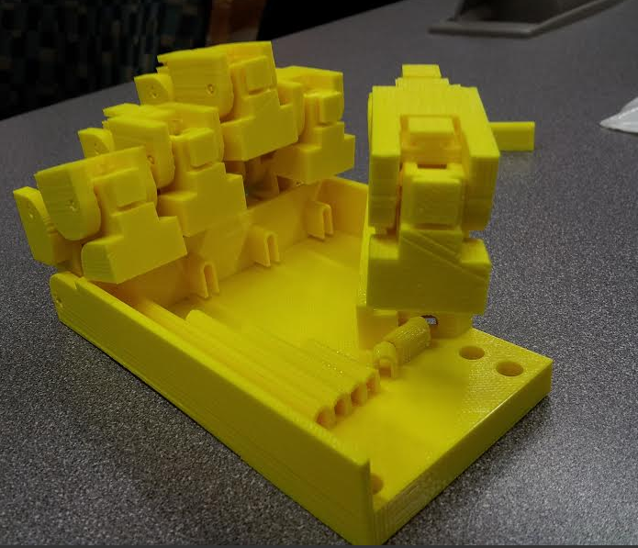
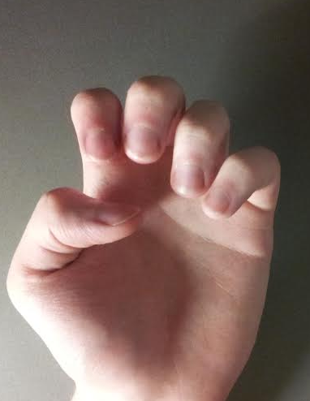
Performance Testing—Points of Failure
Finger tolerance was too small
Friction within joint segments, bridging occurred
Cable guides detached from palm surface
This was entirely a design error, which has since been rectified
Thumb bends incorrectly
This is a major issue that will need to be addressed for the next iteration
Hand model compared to a human hand—demonstrating correct finger motion and incorrect thumb.

Slide 20
Prototype—Moving Forward
Wire guide placement issue has already been fixed
Plastic thickness at forearm attachment point has been reduced
This reduces weight of the hand and amount of plastic used
Wire guides will be redesigned
Testing showed that the wire guides could be about half their current height and still be effective
Making them shorter will allow more space for the granular jamming pad
They will also be changed to a solid post with a circular hole at the top
this is to make threading the wire guides easier
Thumb must be redesigned
This will be the most involved part of the next iteration
The angle of attachment can be mirrored, causing the hand to have an unnatural resting state, or the overall design of the thumb as another finger will be revisited

Slide 21
Gantt Chart
GANTT CHART GOES HERE

Slide 22
The palm design was roughed out at the end of phase 3
However there was an understanding that it was not ready for manufacture

Slide 23
Bill of Materials
BOUGHT/UNBOUGHT BILL OF MATERIALS GOES HERE
(SPECIFY WHICH THINGS WE HAVE ALREADY PURCHASED)

Slide 24
IMPORTANT NOTE
MAKE SURE TO EMPHASIZE CHANGES WE MADE DUE TO PANEL COMMENTS
EXAMPLES ARE: conical joint pins, granular jamming pad on palm only, etc.
Just because they didn’t offer any comments during the very last phase doesn’t mean we shouldn’t mention comments they made earlier.

